Slide 1
Brexit Vegetarian and Vegan Labelling
Stephen Pugh
www.eufoodlabellingspecialists.eu

Slide 2
Presentation
Brexit
Current V&V guides
Problems
Solutions
Commission action – still relevant?
Future action

Slide 3
Brexit:What might change? How will it affect the landscape?
Brexit – a move towards common law
Food producers become responsible – see Food Safety Act
Change in role of Government
Move towards industry-led guidance?
New regulations?
Voluntary cool?

Slide 4
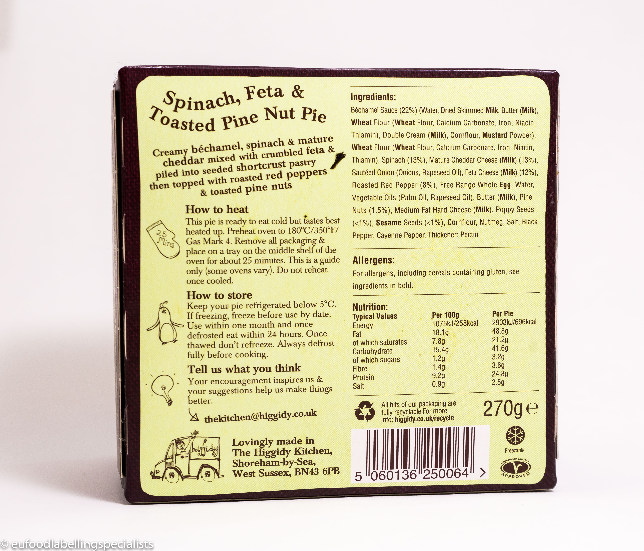

Slide 5
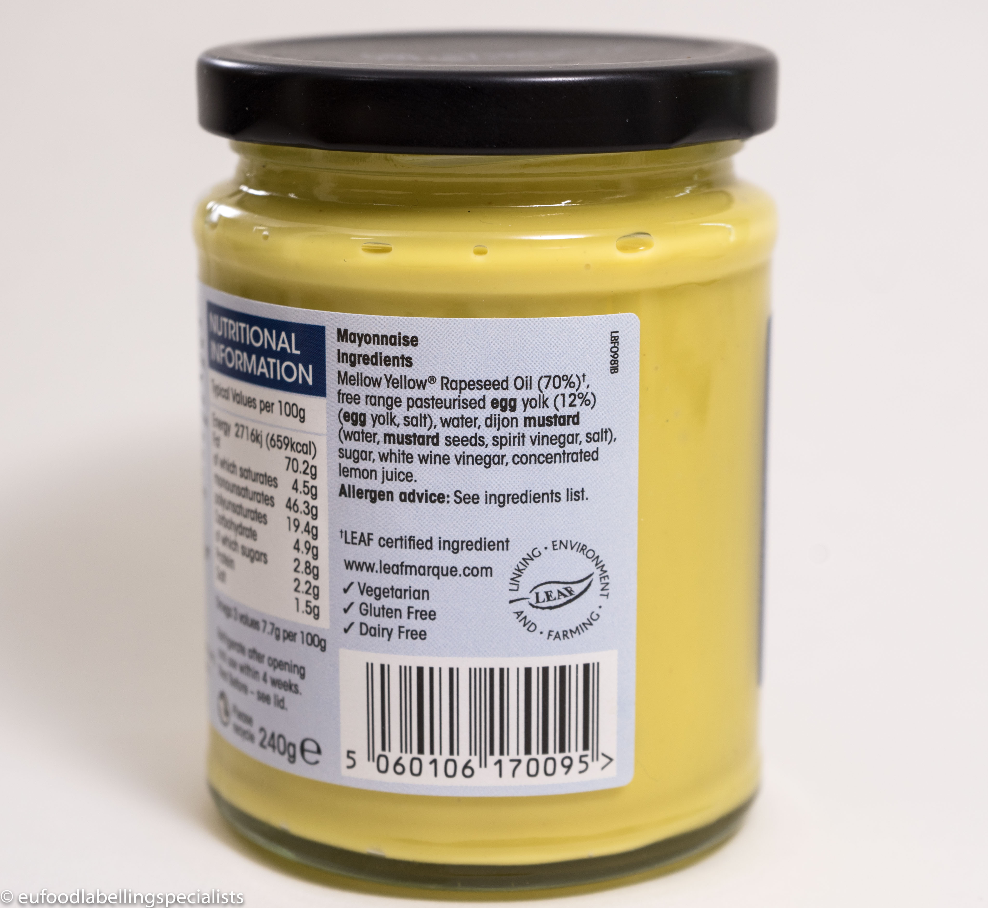

Slide 6
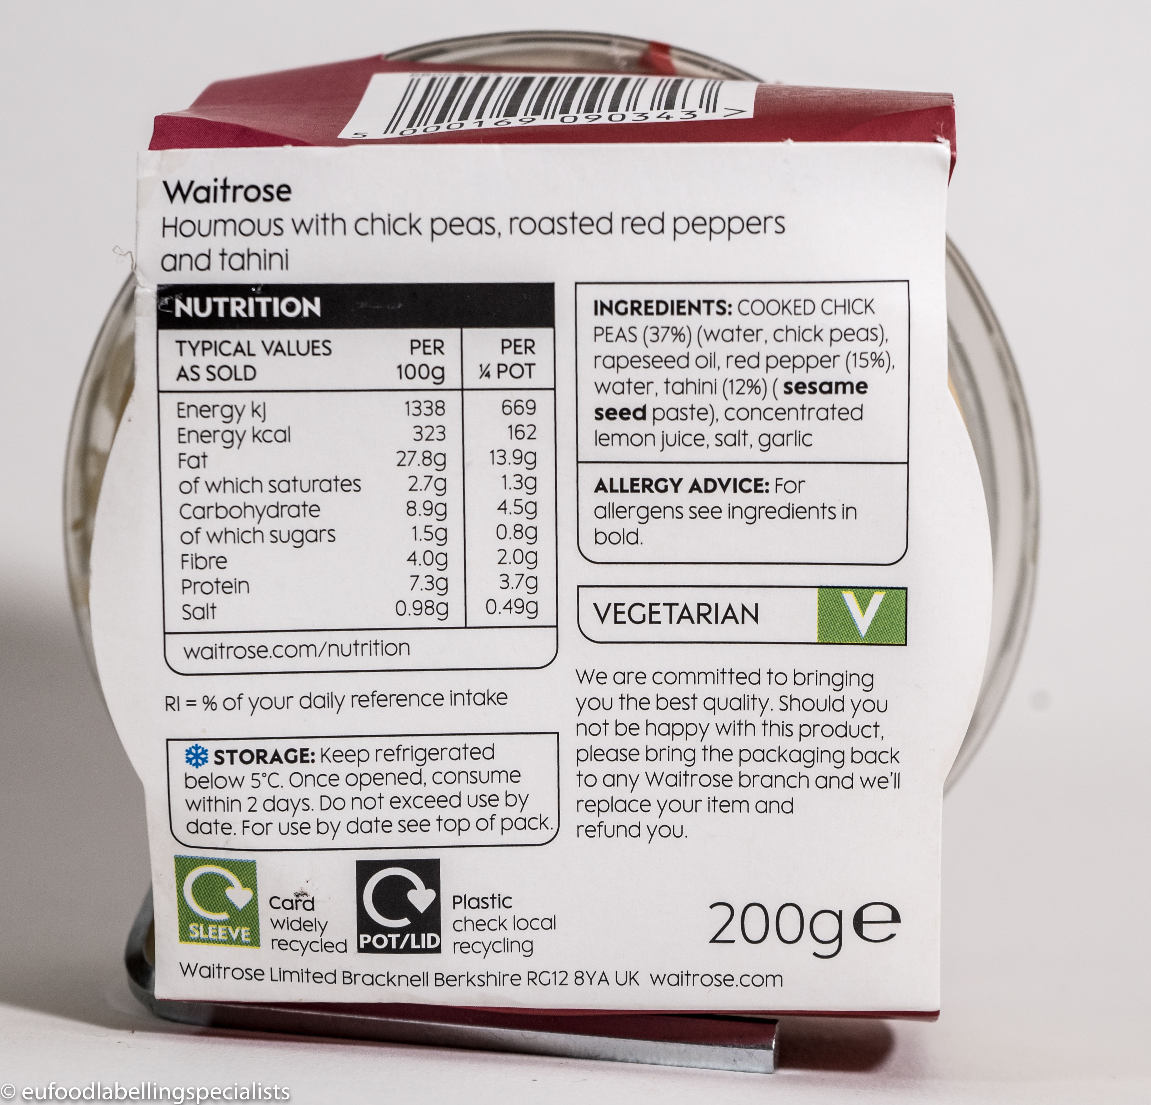

Slide 7
